Slide 1
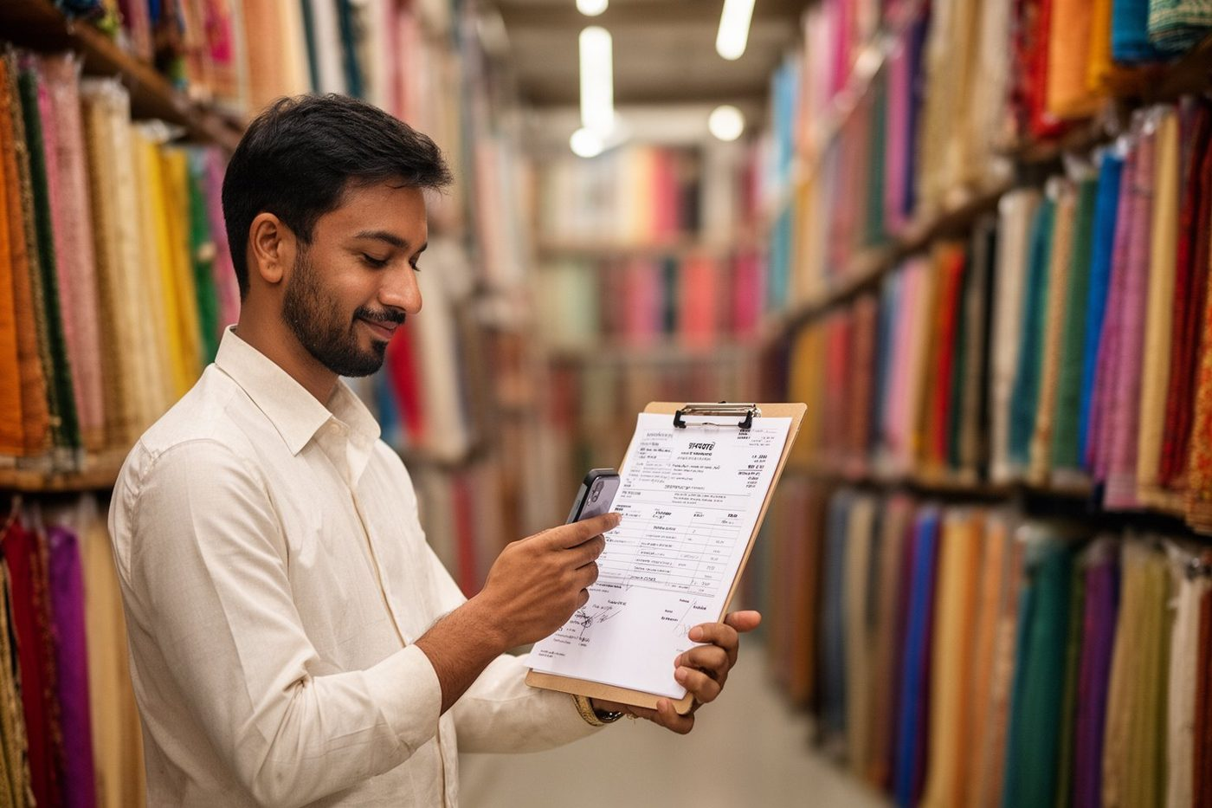
Your customers and suppliers talk to a smart ERP — 24×7, in their own language
MERCIGLOBAL CLOUD ERP · AI CUSTOMER EXPERIENCE
Bills, invoices, reminders, payments and queries on autopilot — for businesses in India and the UAE.
merciglobal.ae · merciglobal.com
Notes:
Welcome. In every meeting, prospects ask us one question: how will Merciglobal improve the experience of my customers and my suppliers? This presentation answers that. In short, your customers and suppliers start talking directly to a smart ERP, on WhatsApp, Telegram, e-mail or a voice call, in their own language, at any hour. The routine work happens on its own, and your team gets its time back.

Slide 2
The question every prospect asks
“How can Merciglobal enhance the experience of my customers and my suppliers / vendors?”
Our answer: Merciglobal automates your workflow and makes your system smart. It reduces errors, bugs, duplication of work and data, and the manpower you need overall — and it works 24×7 without waiting for anyone.
Every automation adds up to better and faster decisions — and finally, a trusted and better brand.
Notes:
When a prospect asks how we improve customer and supplier experience, the answer is simple. Merciglobal automates the workflow and makes the system smart. That means fewer errors and bugs, no duplicate work or duplicate data, and fewer people needed for routine jobs. It runs twenty four by seven. Over time, every one of these automations helps the business decide faster and builds a brand that customers and suppliers trust.

Slide 3





What “a smart system” means for you
Automates the workflow
Removes errors
Ends duplication
Needs fewer hands
Makes the system smart
Routine entries, postings, reminders and confirmations run on their own.
Documents are read by AI and validated against your masters before anything is posted.
Data is captured once, at the source, and flows to every ledger and report.
Clerical keying, chasing and matching shrink, so your team does higher-value work.
It understands photos, PDFs, voice and plain language, in Indian languages and Arabic.
Notes:
Five things change. First, the workflow is automated: entries, postings, reminders and confirmations run on their own. Second, errors drop, because documents are read by AI and checked against your masters before anything is posted. Third, duplication ends: data is captured once, at the source. Fourth, you need fewer hands for keying, chasing and matching. And fifth, the system becomes smart: it understands photos, PDFs, voice and plain language, in Indian languages and Arabic.

Slide 4
Supplier experience: purchase on autopilot
A photo of the bill is all your supplier sends.
Notes:
Let us start with suppliers and vendors. Today, someone in your office collects their bills, types them in and checks them. With Merciglobal, a photo or PDF of the bill is all the supplier needs to send.

Slide 5






From WhatsApp photo to posted ledger — no typing
01
02
03
Supplier sends the bill
Number validated
AI reads the document
A photo or PDF of the invoice goes to your WhatsApp or Telegram bot, from the supplier's registered mobile.
The ERP checks the mobile against the account / agent master. Unknown numbers are never posted.
Party, bill no., date, items, quantity, rates, taxes and totals are extracted and cross-checked.
04
05
06
Purchase entry auto-created
Forwarded if you are an agent
Ledger & payment plan
The purchase is booked against that supplier's account, with the document attached.
In an agency business the bill is passed on to the buyer automatically.
Accounts are posted, due days and amount noted, and a payment plan generated.
Notes:
Here is the flow. One: the supplier sends the bill to your WhatsApp or Telegram bot, from the mobile number registered in your account or agent master. Two: the ERP validates that number. Unknown numbers are never posted. Three: AI reads the document, picking up the party, bill number, date, items, quantities, rates, taxes and totals, and cross-checks them. Four: the purchase entry is created against that supplier, with the document attached. Five: if you are in an agency business, the bill is forwarded to the buyer automatically. Six: the ledger is posted, the due days and amount are noted, and a payment plan is generated as per the due days.

Slide 6

Customer experience: receivables on autopilot
From sales order to settled payment — without a chase.
Notes:
Now the customer side. The goal is simple: from sales order to settled payment, without anyone in your office having to chase.

Slide 7






Six steps that run themselves
01
02
03
04
05
06
Invoice from the sales order
Reminders that run themselves
Customer confirms or pays
AI matches the payment
Adjusted in full or part
Everyone is told
For non-agency businesses the invoice is generated against the sales order automatically.
E-mail, WhatsApp, Telegram, or an AI voice call in the customer's own language.
Confirmations are taken; the payment screenshot or details come back to the bot.
Matched to the best pending invoices, with that account's discount and interest rules.
Settled against one or many invoices, balances carried forward correctly.
Confirmation to the supplier (agency business) or to accounts and management.
Notes:
One: for non-agency businesses, the invoice is generated against the sales order automatically. Two: reminders go out on their own, by e-mail, WhatsApp, Telegram, or an AI voice call in the customer's own language. Three: confirmations are taken, and when the customer pays, the payment screenshot or details come back to the bot. Four: AI matches the payment against the pending invoices, applying the discount and interest rules set for that account. Five: it is adjusted in full or in part against the best matched invoices. Six: a confirmation goes to the supplier in an agency business, or to your accounts team and management in other businesses.

Slide 8




Reminders on every channel — even a polite AI phone call
E-mail
Invoice copy and statement, on schedule.
WhatsApp
Due amount, invoice and a pay link or confirm button.
Telegram
The same, for customers who prefer Telegram.
AI voice call
In the Indian context, in Hindi, Gujarati, English or another language — records the promise-to-pay.
Notes:
Reminders are where most businesses lose time. With Merciglobal, they go out automatically on every channel: e-mail, WhatsApp and Telegram. And where a call works better, an AI voice calls the customer, politely, in the Indian context and in their own language. It reminds them of the amount and the invoice, takes their confirmation or promise to pay, and records it in the ERP. If the customer wants a person, it hands over to your team.

Slide 9
A screenshot in. The right invoices settled.
Matched against pending invoices
using that account's discount and interest rules.
Adjusted in full or part
against the best match; the balance stays open on the right invoice.
Everyone is told
the supplier in an agency business; accounts and management otherwise.
Payment screenshot received
Kavya Fabrics · UTR 6114 8820
₹2,00,000
INV-1021 · due ₹1,20,000
₹1,20,000
Settled in full
INV-1034 · due ₹1,10,000
₹80,000
Part paid · ₹30,000 still due
Paid within due days, so no interest. Confirmation sent to the supplier and to accounts.
Notes:
Here is an example. A customer pays two lakh rupees and sends the screenshot to the bot. The ERP reads it and matches it to their pending invoices. Invoice ten twenty one, for one lakh twenty thousand, is settled in full. Invoice ten thirty four, for one lakh ten thousand, gets the remaining eighty thousand, and thirty thousand stays open against it. Because the payment came within the due days, no interest applies. If the account had a cash discount rule, it would have been applied automatically. A confirmation then goes to the supplier in an agency business, or to accounts and management. Nobody had to match bank lines by hand.

Slide 10
“What do I owe?” — asked by voice, answered in seconds
Customers and suppliers ask for their own ledger, invoice copy, dues and order status by typing or speaking — and get the answer in the same chat, in the same language.
हिन्दी
English
मेरा कुल बकाया कितना है?
Send me my ledger for this quarter.
आपके 3 बिल बाकी हैं, कुल ₹2,45,000। सबसे पुराना INV-1034 है, जो 12 दिन से ओवरड्यू है। क्या मैं बिल की कॉपी भेज दूँ?
Here is your ledger from 1 July to today: opening ₹1,20,000, bills ₹6,80,000, payments ₹5,55,000, closing ₹2,45,000. PDF attached.
ગુજરાતી
العربية
મારું કુલ બાકી કેટલું છે?
كم المبلغ المستحق علي؟
તમારા 3 બિલ બાકી છે, કુલ ₹2,45,000. સૌથી જૂનું INV-1034 છે, જે 12 દિવસથી ઓવરડ્યુ છે. બિલની કૉપી મોકલું?
لديك 3 فواتير مستحقة بإجمالي 48,500 درهم. أقدمها INV-1034 متأخرة 12 يومًا. هل أرسل لك نسخة من الفاتورة؟
Notes:
Customers and suppliers can also serve themselves. They type or speak a question in their own language, Hindi, English, Gujarati, Arabic or another one, and the answer comes back in the same chat window within seconds. For example, a customer asks in Hindi how much they owe, and is told they have three bills pending, totalling two lakh forty five thousand, with the oldest twelve days overdue, and is offered the bill copy. They only ever see their own account. Nobody waits for office hours, and nobody in your office stops work to look it up.

Slide 11

Any photo in — the closest products out, in about a second
SKU SR-4471 · Banarasi silk, maroon
98%
SKU SR-4468 · Banarasi silk, wine
93%
SKU SR-3902 · Kanjivaram, maroon
88%
When product or SKU images are kept in the ERP, a customer, vendor or manager can send any photo and get the closest matches with stock and price — for faster order conversion, information exchange and decisions.
Notes:
If your product or SKU images are managed in the Merciglobal ERP, the system can also match a random image. A customer, a vendor or your own management sends any photo, for example a saree swatch, and within about one second the system returns the closest matching products from your catalogue, with stock and price. That speeds up order conversions, information exchange and decision making.

Slide 12


AI that serves your customers around the clock
AI Chatbot
AI LiveAvatar
AI Voice Calls
AI Auto-Fix Support (TTS)
Ledgers, dues, invoice copies, stock and order status
Takes orders, confirmations and payment proofs
Raises a ticket when something needs a person
Hindi, Gujarati, English and more
Presents products, demos and trainings
Answers questions live, grounded in your material
Due reminders with amount and invoice
Records the promise-to-pay or dispute
Hands over to your team when asked
Telegram, voice note or Raise Ticket in the ERP
Fixed on a copy first, with before/after proof
Most fixes land the same day
Notes:
Four AI services work for your customers all day and all night. The AI Chatbot, on WhatsApp, Telegram and your website, answers from your own ERP data, takes orders, confirmations and payment proofs, and raises a ticket when a person is needed. The AI LiveAvatar is a lifelike video presenter that talks with visitors in their own language. AI Voice Calls handle reminders and confirmations by phone. And our AI Auto-Fix support system, TTS, fixes reported problems around the clock.

Slide 13



AI LiveAvatar — answers in your customer's language
Speaks their language
Hindi, Gujarati, English and more — it listens and replies by voice.
Presents and demonstrates
Products, demos and trainings, slide by slide, without a presenter in the room.
Answers live
Questions are answered on the spot, grounded in your own material.
Notes:
The AI LiveAvatar is the most personal of these. It is a lifelike video presenter. It listens to the customer, understands Hindi, Gujarati, English and other languages, and replies by voice in the same language. It can present your products, run a demo or a training slide by slide, and answer questions live, grounded only in your own material. It is the experience of a senior person in the room, available whenever the customer is.

Slide 14



TTS — our support desk works autonomously, 24×7
Report
Logged
Reproduced
Fixed & tested
Deployed
You're told
Telegram, voice note or Raise Ticket
Ticket number back at once
On a copy of your ERP, never live data
Before/after screenshots as proof
Checked again on the live system
Plain-language closure on Telegram
Bug fixes are free on every plan. Most AI fixes land the same day — live numbers are published at merciglobal.ae/ai-support.
Notes:
Experience also means support. Our ticket system, TTS, runs with an AI auto-fix queue. A client reports a problem by Telegram message, a voice note in Hindi, Gujarati, English or Hinglish, or Raise Ticket inside the ERP. The ticket number comes back at once. The AI reproduces the problem on a copy of the client's ERP, never on live data, fixes it, tests it with before and after screenshots, deploys it, checks it again on the live system, and sends a plain-language closure note. Bug fixes are free on every plan, and most fixes land the same day. The live numbers are on our AI support page.

Slide 15
One connected suite — nothing entered twice
Tasks Diary — Every task, promise and follow-up written once and carried forward until done.
Task Management — Assign, track and remind across teams, with Telegram alerts.
Blacklist — Check every new party by GSTIN, PAN or mobile before you extend credit — stop forged deals early.
E-Commerce Sync — Marketplace orders, stock and prices kept in sync with your ERP.
Websites & Online Stores — Your website or online store, live in minutes, connected to your catalogue.
Business Dashboards — Live, access-controlled numbers for owners and managers.
Ask AI — Ask your ERP a question in plain language and get the answer from your own data.
HRMS & Payroll — Attendance, face punch, leave and payroll — India and UAE.
Tasks Diary
HRMS & Payroll
Task Manager
Merciglobal
Cloud ERP
Ask AI
Blacklist
Dashboards
E-Commerce Sync
Websites & Stores
Notes:
All of this lives in one connected suite, so nothing is entered twice and every team sees the same truth. Around the Merciglobal Cloud ERP sit Tasks Diary and Task Management for follow-ups, Blacklist for party risk, E-Commerce Sync, Websites and online stores, Business Dashboards, Ask AI for questions in plain language, and HRMS and payroll.

Slide 16


Tasks, trust and online sales — part of the same system
Tasks Diary
Blacklist
E-Commerce Sync
Every task, promise and follow-up is written once and carried forward until it is done — with reminders on Telegram. No customer commitment is forgotten.
Check a new party by GSTIN, PAN or mobile before you extend credit. Guards against forged transactions, bounced cheques and parties who vanish with goods.
Marketplace orders, stock and prices stay in sync with the ERP, and your own website or online store goes live in minutes.
Notes:
Three parts of the suite deserve a special mention. The Tasks Diary keeps every task, promise and follow-up until it is done, so no commitment to a customer is forgotten. Blacklist lets you check any new party by GSTIN, PAN or mobile before extending credit, and protects you from forged transactions and defaulters. And E-Commerce Sync keeps marketplace orders, stock and prices in step with the ERP, while your own website or online store can go live in minutes.

Slide 17
The same work — without the manual part
Activity | Usually | With Merciglobal
Supplier bills | Collected, keyed in and checked by hand | Read by AI and posted against the right account
Payment follow-up | Calls and messages from a person, when time allows | Scheduled reminders and AI calls, every day, on time
Payment matching | Bank lines and screenshots matched manually | Matched to the best pending invoice, rules applied
Customer queries | Wait for office hours and a free person | Answered at once, 24×7, in their own language
Finding a product | Scroll catalogues, ask someone who remembers | Snap a photo — the closest SKUs in about a second
New party risk | Trust and hope | Blacklist check before the first invoice
Notes:
Put side by side, the difference is clear. Supplier bills that were collected, keyed in and checked by hand are read by AI and posted. Payment follow-up that happened when someone had time now happens every day, on time. Payment matching is automatic. Customer queries are answered at once, twenty four by seven, in their own language. Finding a product takes a photo. And new party risk is checked before the first invoice.

Slide 18



What it adds up to
Cost saving
Manpower saving
Accuracy
Speed
Trust & brand
Less clerical work, fewer write-offs, fewer missed dues.
Keying, chasing and matching move to the machine.
Validated numbers, documents and masters; no double entry.
Seconds instead of hours, every hour of every day.
Customers and suppliers feel served — and remember it.
Notes:
So what does it add up to? Cost saving, because there is less clerical work, fewer write-offs and fewer missed dues. Manpower saving, because keying, chasing and matching move to the machine. Accuracy, because numbers, documents and masters are validated. Speed, seconds instead of hours, every hour of every day. And finally trust: customers and suppliers feel well served, and they remember it. That is how technology turns into a better brand.

Slide 19

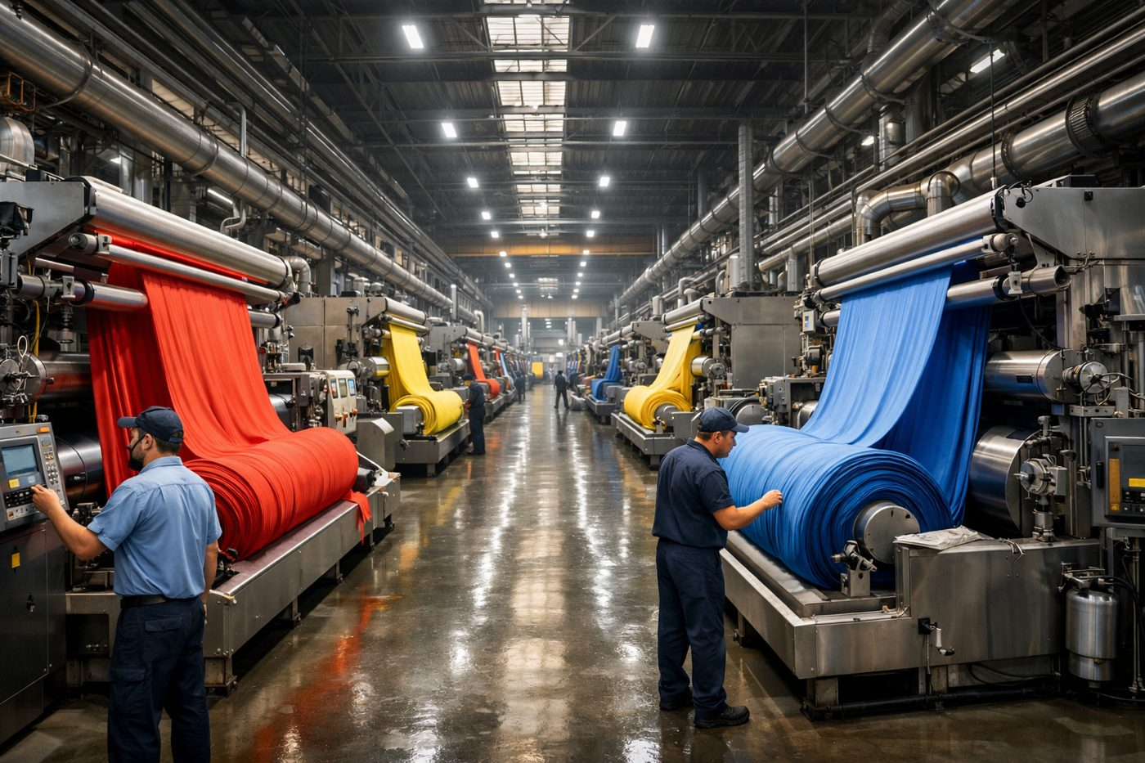



Built for every business that buys, sells and collects
Weaving & Textiles
Dyeing & Printing
Paper
Gold & Jewellery
Engineering & Fenestration
Trading, Agency & Distribution
Notes:
This is not specific to one industry. Any business that buys, sells and collects benefits: weaving and textiles, dyeing and printing, paper, gold and jewellery, engineering and fenestration, and trading, agency and distribution houses, as well as services. The same automations serve them all.

Slide 20

World-class customer experience — in India and the UAE
India
UAE
GST-ready · Hindi, Gujarati and other Indian languages · Crore/Lakh formatting · WhatsApp-first customers · AI voice calls in the Indian context
VAT-ready · Arabic and English · AED · the same 24×7 automation for trading houses and manufacturers in the Gulf
Notes:
We serve clients in India and the UAE. In India the system is GST-ready, speaks Hindi, Gujarati and other Indian languages, formats amounts in lakhs and crores, and reaches WhatsApp-first customers, including by AI voice call. In the UAE it is VAT-ready, works in Arabic and English and in dirhams, with the same twenty four by seven automation. The aim is customer experience at the level of the best in the world.

Slide 21
Questions prospects ask
Unknown number?
Agency business?
Nothing is posted. Only numbers registered in your account or agent master are accepted.
Yes. Bills are forwarded to the buyer; payment confirmations go back to the supplier.
Discounts and interest?
Which languages?
Each account's rules are applied when a payment is matched, in full or in part.
Hindi, Gujarati, English, Arabic and other languages — by text or by voice.
Which businesses?
Is our data safe?
Manufacturing, trading, agency, distribution and services, in India and the UAE.
Each client has its own database; a party sees only its own records; every action is logged.
Notes:
These are the questions prospects ask most. Question: How does Merciglobal improve my customer and supplier experience? Answer: It automates the workflow end to end. Suppliers send bills to a WhatsApp or Telegram bot and the purchase is booked automatically; customers get invoices, reminders and confirmations on their own channel and can ask for their ledger or dues any time, in their own language. Fewer errors, no duplicate entry, fewer people needed, and service that runs 24×7. Question: How does a supplier's invoice get into the ERP without anyone typing it? Answer: The supplier sends a photo or PDF of the bill to your bot from a mobile number registered in your account or agent master. The ERP validates the number, AI reads the document, and a purchase entry is created against that supplier with the document attached. Ledger posting, due days, amount and a payment plan follow automatically. Question: What if the message comes from an unknown number? Answer: Nothing is posted. Only numbers registered against an account or agent in your ERP are accepted; anything else is held for a person to review. Question: We are commission agents. Does this work for an agency business? Answer: Yes. The supplier's bill can be forwarded to the buyer automatically, and when the buyer pays, the confirmation goes back to the supplier. For non-agency businesses the confirmation goes to your accounts team and management instead. Question: How are customer payments matched to invoices? Answer: The customer sends the payment screenshot or details to the bot. It is matched to the best pending invoices, applying that account's discount and interest rules, and adjusted in full or in part. The remaining balance stays open against the right invoice. Question: Can customers ask for their own ledger or invoice copy? Answer: Yes. They type or speak the question in Hindi, English, Gujarati, Arabic or another language, and get the ledger, dues or invoice copy back in the same chat, within seconds. They only ever see their own account. Question: What is the AI voice reminder? Answer: An AI voice call, in the Indian context and in the customer's language, that reminds them of the due amount and invoice, takes a confirmation or promise-to-pay, and records it in the ERP. Question: What is the AI LiveAvatar? Answer: A lifelike video presenter that speaks with your visitors and customers in their own language, presents products or demos, and answers questions live from your material. Question: What is image-based product search? Answer: If product or SKU images are kept in the ERP, anyone can upload a random photo and the system finds the closest matching products in about a second — helping faster order conversion and decisions. Question: What does the TTS support system do? Answer: It is our ticket system with AI auto-fix. You report a problem by Telegram, voice note or the ERP; the AI reproduces it on a copy of your ERP, fixes and tests it with before/after proof, deploys it and tells you — around the clock. Question: How do Diary, Blacklist and E-Commerce fit in? Answer: Tasks Diary keeps every follow-up and promise until it is done. Blacklist checks a new party by GSTIN, PAN or mobile before credit is extended, guarding against forged or fraudulent deals. E-Commerce sync keeps marketplace orders, stock and prices in step with the ERP. Question: Which businesses is this for, and where? Answer: Any business that buys, sells and collects — manufacturing, trading, agency, distribution and services — across India and the UAE, with GST and VAT, Indian languages and Arabic. Question: Is our data safe? Answer: Each client's data stays in its own project database; a customer or supplier can reach only their own records, and every automated action is logged for audit.

Slide 22
See your own bills, customers and payments run on autopilot
NEXT STEP
A live demo on your kind of business, in the language your team speaks.
Book a demo: merciglobal.ae/contact-us
Info@merciglobal.com · +91 76220 14301
Notes:
The best way to see this is on your own kind of business. We will run a live demo, in the language your team speaks, showing your bills, your customers and your payments running on autopilot. You can book it at merciglobal dot ae slash contact us. Thank you.

